Slide 1
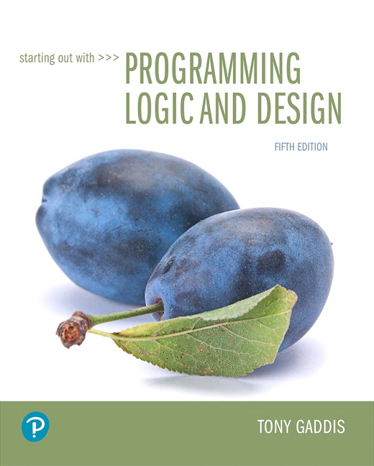
Starting out with Programming Logic and Design
Fifth Edition
Chapter 8
Arrays
Copyright © 2016, 2013, 2010 Pearson Education, Inc. All Rights Reserved
Notes:
If this PowerPoint presentation contains mathematical equations, you may need to check that your computer has the following installed:
1) MathType Plugin
2) Math Player (free versions available)
3) NVDA Reader (free versions available)

Slide 2
Learning Objectives
8.1 Array Basics
8.2 Sequentially Searching an Array
8.3 Processing the Contents of an Array
8.4 Parallel Arrays
8.5 Two-Dimensional Arrays
8.6 Arrays of Three or More Dimension

Slide 3
8.1 Array Basics (1 of 9)
An array allows you to store a group of items of the same data type together in memory
Why? Instead of creating multiple similar variables such as employee1, employee2, employee3 and so on…
It’s more efficient to create just one variable
Declare String employees[50]
Declare Real salesAmounts[7]
The number in the [ ] is the size of the array

Slide 4
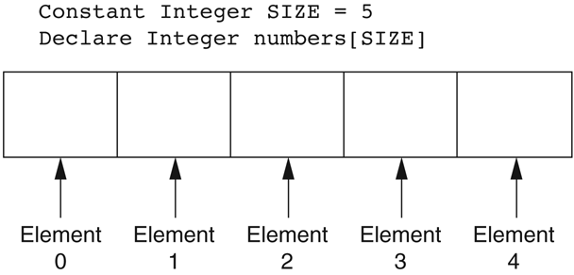
8.1 Array Basics (2 of 9)
The storage locations in an array are elements
Each element of the array has a unique number called a subscript that identifies it – the subscript starts at 0 in most languages.
Figure 8-1 Array subscripts

Slide 5
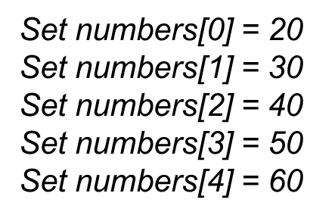
8.1 Array Basics (3 of 9)
Assigning values can be done individually using a subscript…
But, it is much more efficient to use a loop to step through the array

Slide 6
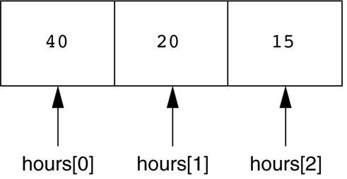
8.1 Array Basics (4 of 9)
Figure 8-3 Contents of the hours array

Slide 7
8.1 Array Basics (5 of 9)
Arrays can be initialized to 0 or specific values
Declare String days[7] = “Sunday”, “Monday”, “Tuesday”, Wednesday”, “Thursday”, “Friday”, “Saturday”
Array bounds checking should be performed to avoid use of an invalid subscript
Days[7] = “Saturday” is invalid because there is no 7 index
A common error is running a loop one time more than is necessary, exceeding the bound of the array
Off-by-one Error

Slide 8
8.1 Array Basics (6 of 9)
Partially Filled Array
Sometimes an array is only partially filled
To avoid processing the unfilled elements, you must have an accompanying integer variable that holds the number of items stored in the array.
When the array is empty, 0 is stored in this variable
The variable is incremented each time an item is added to the array
The variable’s value is used as the array’s size when stepping through the array.

Slide 9
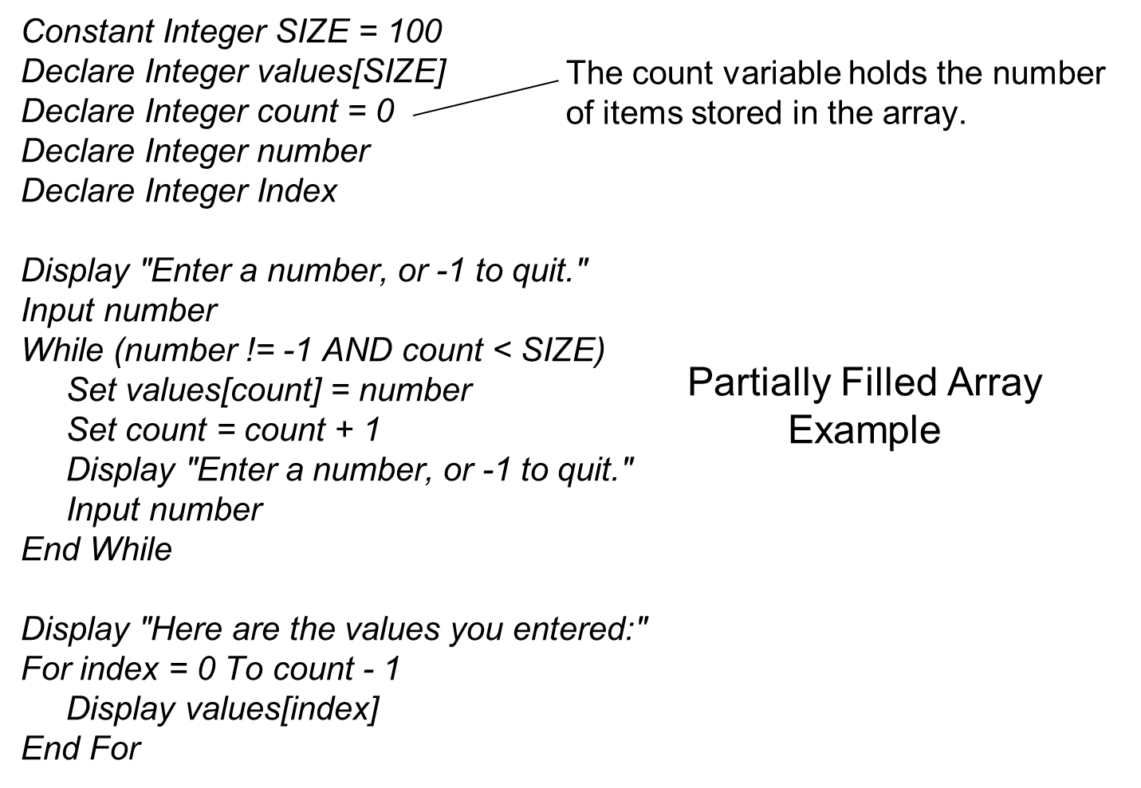
8.1 Array Basics (7 of 9)

Slide 10
8.1 Array Basics (8 of 9)
Optional Topic: The For Each Loop
Some languages provide a For Each loop
It works with an array, iterating once for each array element
During each iteration, the loop copies an element’s value to a variable.

Slide 11
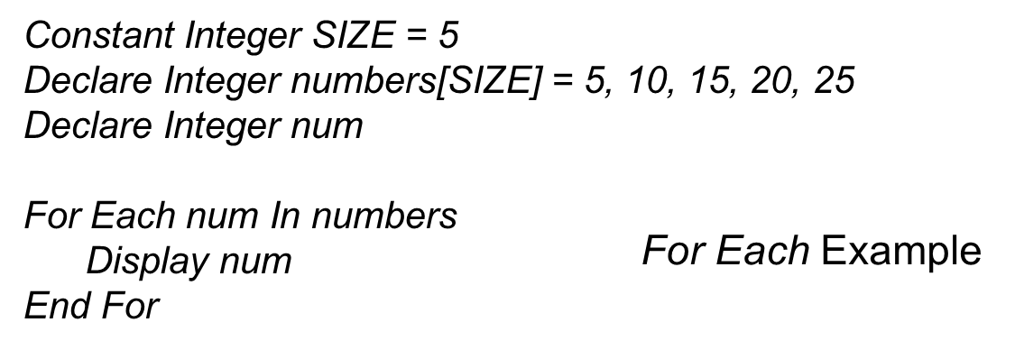
8.1 Array Basics (9 of 9)

Slide 12
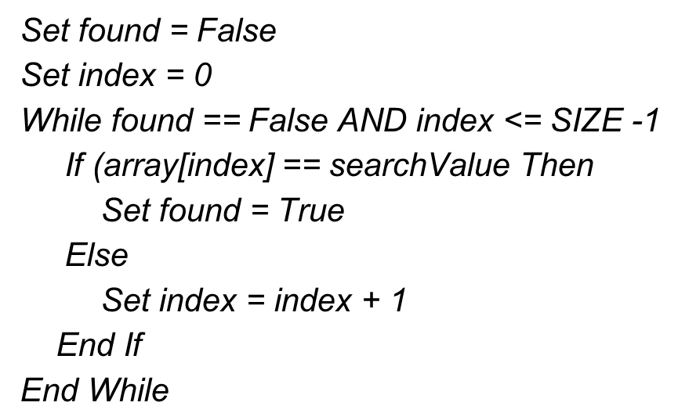
8.2 Sequentially Searching An Array
A sequential search algorithm is a simple technique for finding an item in a string or numeric array
Uses a loop to sequentially step through an array
Compares each element with the value being searched for
Stops when the value is found or the end of the array is hit

Slide 13
8.3 Processing the Contents of an Array (1 of 3)
Totaling the values in an array and calculating average
Loops are used to accumulate the values
Then, the total is simply divided by the size

Slide 14
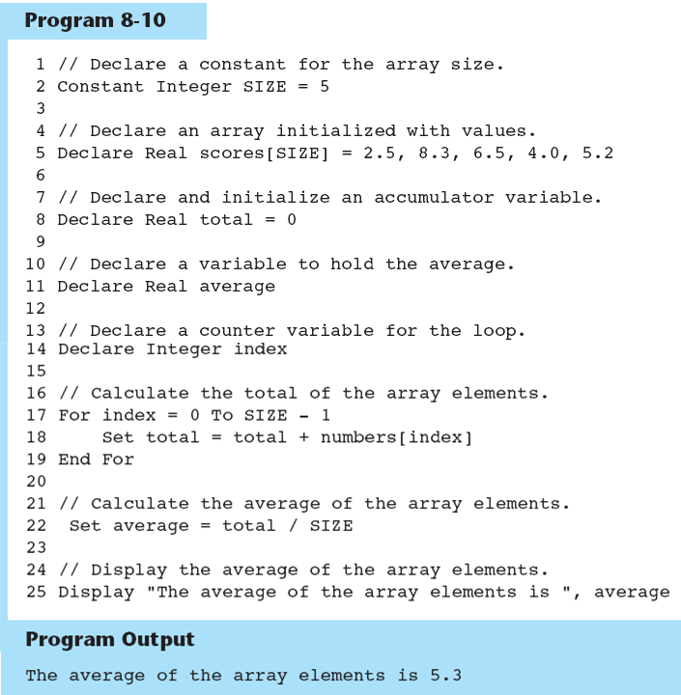
Example

Slide 15
8.3 Processing the Contents of an Array (2 of 3)
Finding the highest & lowest values in an array
The highest
Create a variable to hold the highest value
Assign the value at element 0 to the highest
Use a loop to step through the rest of the elements
Each iteration, a comparison is made to the highest variable
If the element is greater than the highest value, that value is then the assigned to the highest variable
The lowest
Same process, but checks if the element is less than the lowest value

Slide 16
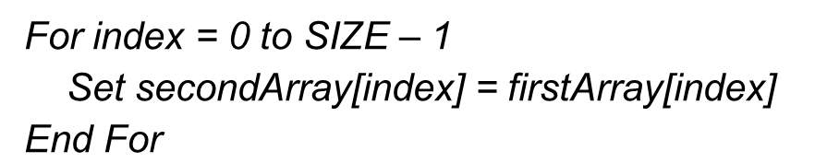
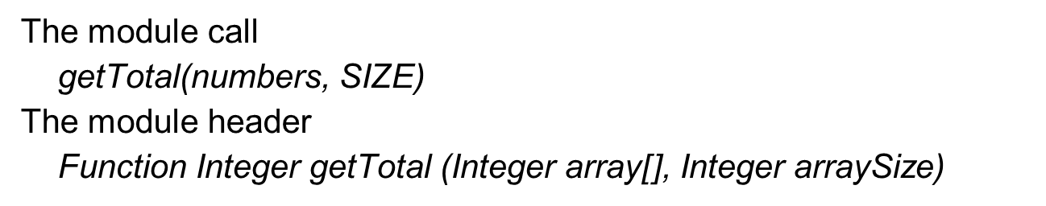
8.3 Processing the Contents of an Array (3 of 3)
Copying an array can be done using loops
Passing an Array as an Argument
Usually must pass the array and the size

Slide 17
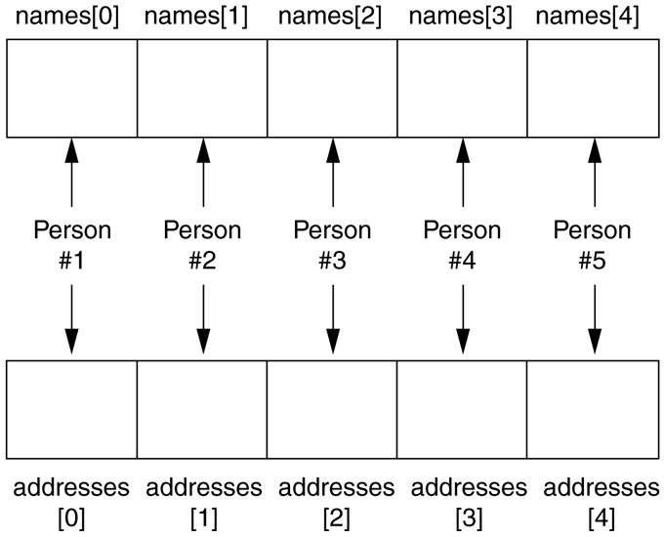
8.4 Parallel Arrays
By using the same subscript, you can establish a relationship between data stored in two or more arrays
Figure 8-14 The names and addresses arrays

Slide 18
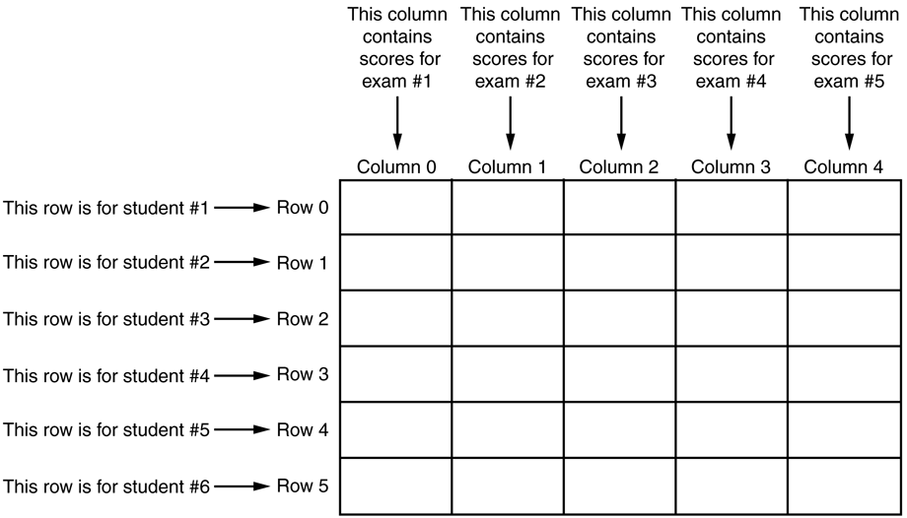
8.5 Two-Dimensional Arrays (1 of 2)
A two-dimensional array is like several identical arrays put together
Suppose a teacher has six students who take five tests
Figure 8-17 Two-dimensional array with six rows and five columns

Slide 19
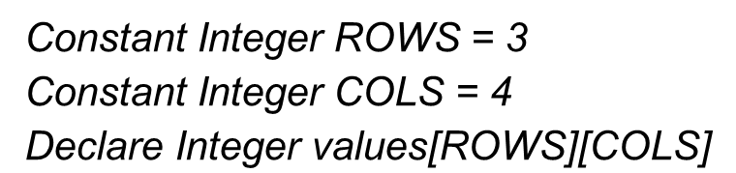
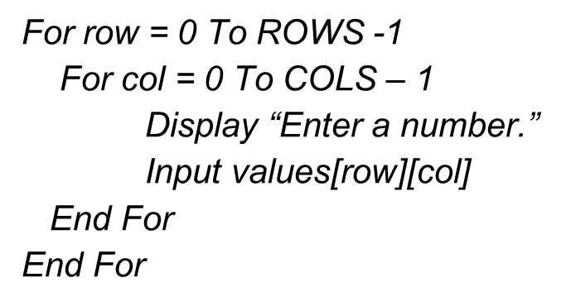
8.5 Two-Dimensional Arrays (2 of 2)
Two size variables are required when declaring
Accessing is done with two loops, and both subscripts

Slide 20
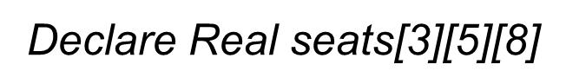
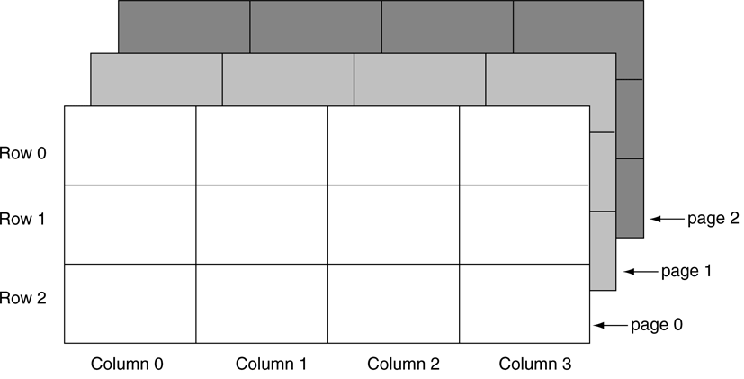
8.6 Arrays of Three or More Dimensions
Arrays can also be three or more dimensions
Figure 8-22 A three-dimensional array

Slide 21
8.7 Focus on Languages: Java

Slide 22
8.7 Focus on Languages: Java (1 of 8)
Java Array Declarations int[] numbers = new int[6];
This statement declares numbers as an int array
The size declarator specifies that the array has 6 elements.
It is a good practice to use a named constant for the size declarator: final int SIZE = 6; int[] numbers = new int[SIZE];

Slide 23
8.7 Focus on Languages: Java (2 of 8)
The following code declares temperatures as an array of 200 doubles: final int SIZE = 200; double[] temperatures = new double[SIZE];
The following code declares names as an array of 10 Strings: final int SIZE = 10; String[] names = new String[SIZE];

Slide 24
8.7 Focus on Languages: Java (3 of 8)
You access the elements of an array with a subscript. Subscripts start at 0.
Example: final int SIZE = 3; int[] numbers = new int[SIZE]; numbers[0] = 10; numbers[1] = 20; numbers[2] = 30;

Slide 25
8.7 Focus on Languages: Java (4 of 8)
Initializing an array: int[] days = {31, 28, 31, 30, 31, 30, 31, 31, 30, 31, 30, 31};
The first value, 31, is stored in days[0]
The second value, 28, is stored in days[1]
And so forth…

Slide 26
8.7 Focus on Languages: Java (5 of 8)
The length attribute holds the number of elements in an array.
For example, look at this declaration: double[] temperatures = new double[25];
Because the temperatures array has 25 elements, the following statement would assign 25 to the variable size: size = temperatures.length;
The length attribute is very useful in a loop: for (int i = 0; i < temperatures.length; i++) System.out.println(temperatures[i]);

Slide 27
8.7 Focus on Languages: Java (6 of 8)
When passing an array as an argument to a method in Java, it is not necessary to pass a separate argument indicating the array's size.
This is because Java arrays have the length attribute that reports the array's size: public static void showArray(int[] array) { for (int i = 0; i < array.length; i++) System.out.print(array[i] + " "); }

Slide 28
8.7 Focus on Languages: Java (7 of 8)
Two-Dimensional Arrays in Java
Here is a declaration of a two-dimensional array with three rows and four columns: double[][] scores = new double[3][4];
The elements in row 0 are referenced as: scores[0][0] scores[0][1] scores[0][2] scores[0][3]
The elements in row 1 are referenced as: scores[1][0] scores[1][1] scores[1][2] scores[1][3]
And so on…

Slide 29
8.7 Focus on Languages: Java (8 of 8)
Arrays with Three or More Dimensions
Here is an example of a three-dimensional array declaration: double[][][] seats = new double[3][5][8];
This array can be thought of as three sets of five rows, with each row containing eight elements.

Slide 30
8.7 Focus on Languages: Python

Slide 31
8.7 Focus on Languages: Python (1 of 7)
In Python, you create lists instead of arrays. even_numbers = [2, 4, 6, 8, 10]
This statement declares even_numbers as list
The items inside the brackets are the elements of the list
Another example: names = ['Molly', 'Steven', 'Will', 'Alicia', 'Adriana']

Slide 32
8.7 Focus on Languages: Python (2 of 7)
You access the elements of a list with a subscript. Subscripts start at 0.
Example: numbers = [0, 0, 0] numbers[0] = 10 numbers[1] = 20 numbers[2] = 30

Slide 33
8.7 Focus on Languages: Python (3 of 7)
The len function returns the number of elements in a list.
In the following code, size will be assigned 3: numbers = [0, 10, 20] size = len(numbers)
The len function is very useful in a loop: my_list = [10, 20, 30, 40] index = 0 while index < len(my_list): print(my_list[index]) index += 1

Slide 34
8.7 Focus on Languages: Python (4 of 7)
In Python you can easily iterate over the elements of a list with a for loop: numbers = [99, 100, 101, 102] for n in numbers: print(n)
The variable n is assigned a copy of the first value in the list, and then the statements that appear in the block are executed.
Then, the variable n is assigned a copy of the next value in the list, and the statements in the block are executed again.
This continues until the variable has been assigned the last value in the list.

Slide 35
8.7 Focus on Languages: Python (5 of 7)
When passing a list as an argument to a function in Python, it is not necessary to pass a separate argument indicating the list's size.
Inside the function, you can use the len function to get the size of the list: def set_to_zero(numbers): index = 0 while index < len(numbers): numbers[index] = 0 index = index + 1

Slide 36
8.7 Focus on Languages: Python (6 of 7)
Two-Dimensional Lists in Python
The following statement creates a two-dimensional list with two rows and three columns: numbers = [ [1, 2, 3], [10, 20, 30] ]
The elements in row 0 are referenced as: numbers[0][0] numbers[0][1] numbers[0][2] numbers[0][3]
The elements in row 1 are referenced as: numbers[1][0] numbers[1][1] numbers[1][2] numbers[1][3]

Slide 37
8.7 Focus on Languages: Python (7 of 7)
Using Nested Loops to Iterate over a Two-Dimensional List:
scores = [ [70, 80, 90],
[80, 60, 75],
[85, 75, 95] ]
NUM_ROWS = 3
NUM_COLS = 3
row = 0
while row < NUM_ROWS:
col = 0
while col < NUM_COLS:
print(scores[row][col])
col = col + 1
row = row + 1

Slide 38
8.7 Focus on Languages: C++

Slide 39
8.7 Focus on Languages: C++ (1 of 8)
C++ Array Declarations int numbers [6];
This statement declares numbers as an int array
The size declarator specifies that the array has 6 elements.
It is a good practice to use a named constant for the size declarator: const int SIZE = 6; int numbers[SIZE];

Slide 40
8.7 Focus on Languages: C++ (2 of 8)
The following code declares temperatures as an array of 200 doubles: const int SIZE = 200; double temperatures[SIZE];
The following code declares names as an array of 10 Strings: const int SIZE = 10; string names[SIZE];

Slide 41
8.7 Focus on Languages: C++ (3 of 8)
You access the elements of an array with a subscript. Subscripts start at 0.
Example: const int SIZE = 3; int numbers[SIZE]; numbers[0] = 10; numbers[1] = 20; numbers[2] = 30;

Slide 42
8.7 Focus on Languages: C++ (4 of 8)
Initializing an array: const int SIZE = 12; int days[SIZE] = {31, 28, 31, 30, 31, 30, 31, 31, 30, 31, 30, 31};
The first value, 31, is stored in days[0], the second value, 28, is stored in days[1], and so forth.
When initializing an array in C++, it is not necessary to specify a size declarator: int days[] = {31, 28, 31, 30, 31, 30, 31, 31, 30, 31, 30, 31};

Slide 43
8.7 Focus on Languages: C++ (5 of 8)
When passing an array as an argument to a function in C++, you should also pass a separate int argument indicating the array's size. void showArray(int array[], int size) { for (int i = 0; i < size; i++) cout << array[i] << " "; }

Slide 44
8.7 Focus on Languages: C++ (6 of 8)
Two-Dimensional Arrays in C++
Here is a declaration of a two-dimensional array with three rows and four columns: double scores[3][4];
The elements in row 0 are referenced as: scores[0][0] scores[0][1] scores[0][2] scores[0][3]
The elements in row 1 are referenced as: scores[1][0] scores[1][1] scores[1][2] scores[1][3]
And so on…

Slide 45
8.7 Focus on Languages: C++ (7 of 8)
Using Nested Loops to Iterate over a Two-Dimensional Array:
const int ROWS = 3;
const int COLS = 4;
double scores[ROWS][COLS];
for (int row = 0; row < ROWS; row++)
{
for (int col = 0; col < COLS; col++)
{
cout << "Enter a score." << endl;
cin >> scores[row][col];
}
}

Slide 46
8.7 Focus on Languages: C++ (8 of 8)
Arrays with Three or More Dimensions
Here is an example of a three-dimensional array declaration: double seats[3][5][8];
This array can be thought of as three sets of five rows, with each row containing eight elements.

Slide 47

Copyright

